Slide 1

Design and Implementation of Smart Borewell Safety System and using Solar Technology
Presented by
Arunadevi A (720821104009)
Divine Angel M (720821104026)
Kaviya K (720821104048)
Keerthika S (720821104049)
Guidance by
Mrs S.Suganya.,M.E.(Ph.D).,
Assistant Professor /ECE.,

Slide 2
Abstract
Borewells are essential sources of groundwater, but abandoned and uncovered borewells pose significant safety hazards, leading to tragic accidents, particularly involving children. This paper presents the design and implementation of a Smart Borewell Safety System utilizing solar technology to ensure an efficient and eco-friendly solution. The proposed system integrates IoT-based sensors to detect unauthorized access, obstacles, or human/animal presence in the borewell. Additionally, an automated covering mechanism is employed to prevent accidental falls.
Solar power is used to ensure continuous operation, reducing dependency on conventional electricity sources and promoting sustainability. The system also features real-time alerts via GSM or IoT networks, allowing immediate response in case of emergencies. This innovative approach aims to enhance borewell safety while leveraging renewable energy, making it a cost-effective and reliable solution for rural and urban areas.

Slide 3
Objective
To develop a smart borewell safety system that can prevent accidents caused by open or abandoned borewells using automated safety mechanisms.
To integrate IoT-based sensors for real-time monitoring of borewell openings, detecting unauthorized access, or detecting the presence of objects, humans, or animals.
To implement an automated borewell covering mechanism that activates when the borewell is not in use, ensuring safety and preventing accidental falls.
To utilize solar energy as a sustainable power source for the system, reducing dependency on conventional electricity and making it suitable for remote areas.
To enable real-time alerts and notifications via GSM, IoT, or wireless communication, ensuring immediate action can be taken in case of emergency.
To enhance public safety and awareness regarding borewell hazards by deploying an efficient and cost-effective solution for both rural and urban environments.
To design a user-friendly and low-maintenance system that can be easily installed and operated by local authorities or borewell owners.

Slide 4
Introduction
Borewells are widely used as a primary source of water in agricultural, industrial, and residential areas. However, open and unattended borewells pose a significant safety risk, particularly to children and animals. Incidents of accidental falls into borewells have raised serious concerns, emphasizing the need for an effective safety mechanism.
The Design and Implementation of a Smart Borewell Safety System Using Solar Technology aims to address these safety challenges through a reliable, automated solution. The system comprises two key components: the Field Device and the Hub Device. The Field Device is strategically installed at a common monitoring location, equipped with sensors such as Passive Infrared (PIR) sensors, ultrasonic sensors, and an RF module for communication. It also incorporates a solar panel for sustainable power management. On the other hand, the Hub Device is placed at the borewell site, consisting of a buzzer, warning indicator, and an RF module to receive alerts.
In the event of unauthorized access or detected movement near the borewell, the system triggers visual and audible alerts through the Hub Device. This proactive notification system enhances the safety of borewells, particularly in remote or unsupervised areas. The incorporation of solar technology ensures the system remains operational without relying on external power sources, making it eco-friendly and cost-effective.

Slide 5
Literature Survey
Author(s) | Year, Volume | Titel | Journal | Description
Utkarsh Sharma, Bhim Singh, Shailendra Kuma | 2017, Vol. 11, Issue 5 | Intelligent Grid Interfaced Solar Water Pumping System | IET Renewable Power Generation | Proposes a solar-powered water pumping system with maximum power tracking and efficient motor drive control.
Anjanee Kumar Mishra, Bhim Singh | 2021, Vol. 14, Issue 5 | Solar-Powered Switched Reluctance Motor-Driven Water Pumping System with Battery Support | IET Power Electronics | Presents a solar water pump with battery storage for continuous operation using a bidirectional DC-DC converter.

Slide 6
Karthick P, Muralidharan R, Pavithra M, Pavithra P, Yuvarani B | 2019, Vol. 8, Suppl. Issue 1 | Smart Borewell Optimizer and Monitoring System to Enhance Borewell Life | South Asian Journal of Engineering and Technology | Develops a system to optimize borewell usage and monitor water levels, preventing borewell depletion.
B.Ravikumar, V. Supriya, E. Meenaloshini, S. U. Teja | 2024, Vol. 7, No. 4 | Solar Powered Smart Irrigation System | International Journal of Research in Engineering, Science and Management | Implements an IoT-based solar-powered irrigation system with soil moisture sensors for efficient water management.
Megha Bhaskar Dharmik, Divya Meshram | 2023, Vol. 4, No. 6 | Solar Powered Smart Irrigation System | Solar Powered Smart Irrigation System | Discusses various smart irrigation systems using solar power and automation for water conservation.

Slide 7
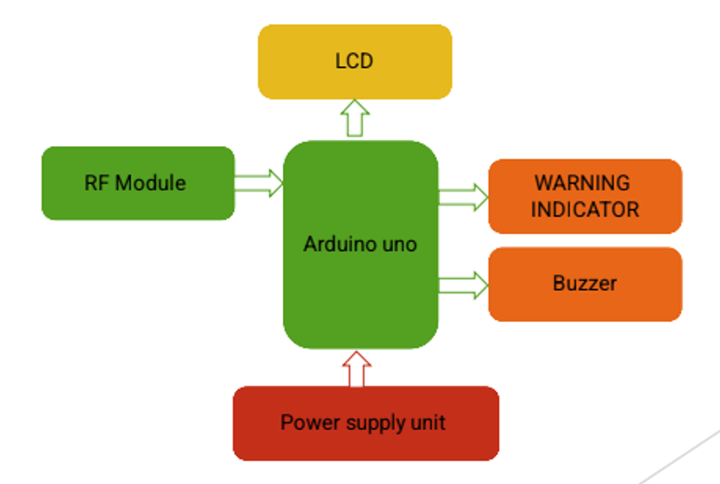
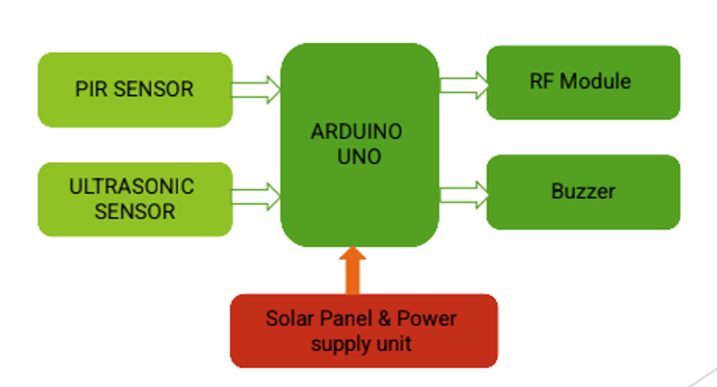
Proposed Methodology
Field Device
Hub Device

Slide 8
System Components & Design
Power Supply & Energy Management
Solar panel powers the system. And Battery storage ensures 24/7 operation.
B. Microcontroller Unit (Processing & Control)
Arduino/Raspberry Pi/ESP32 processes sensor data and controls actions.
C. Sensor-Based Monitoring
Ultrasonic Sensor: Detects obstacles/objects near the borewell
IR Sensor/Camera Sensor: Identifies unauthorized movement.
Water Level Sensor: Monitors groundwater levels.
D. Automated Borewell Cover
Motorized lid opens when in use, closes when idle. And Controlled via relay circuits based on sensor input.
E. Emergency Alert & Communication System
GSM Module/loT: Sends SMS/notifications to authorities & users.
Buzzer & LED Indicators: Alerts for unauthorized access or hazards.

Slide 9
Working Principle&Implementation Steps
Step 1: Solar Power Management
Solar panel charges a battery for 24/7 power. And Power unit regulates voltage for components.
Step 2: Real-Time Monitoring & Detection
Sensors scan borewell entry & surroundings.
Detects movement, obstacles, or human presence, triggering alerts.
Step 3: Automated Borewell Cover Operation
Motorized cover stays closed when not in use. And Shuts immediately on unauthorized access or falls.
Step 4: Alert & Notification System
Buzzer & LED activate on detection. And GSM/IoT sends alerts to authorities & users.
Updates location & status.

Slide 10
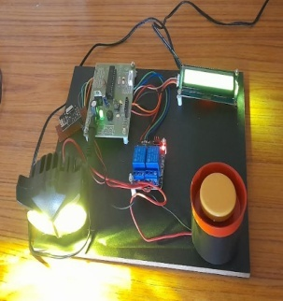
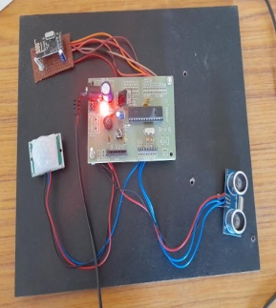
Hub Device
Field Device

Slide 11
Implementation output
The implementation output of the Smart Borewell Safety System effectively ensures borewell safety. In normal conditions, the field device continuously monitors using PIR and ultrasonic sensors, with the hub device displaying “Good“. When motion is detected, the field device sends a signal via the RF module, triggering the hub device to activate the buzzer and LED indicator, displaying "Warning: Motion Detected.
In the event of a fall, the ultrasonic sensor sends an emergency signal, causing the hub device to emit a continuous buzzer sound and display "Emergency: Fall Detected." The system operates on solar power with battery backup, ensuring uninterrupted functionality. Real-time communication between the devices is maintained, with any loss of connection displayed as "Connection Error." This reliable system provides immediate alerts, enhances borewell safety, and minimizes potential accidents, making it a practical and efficient solution for borewell management.

Slide 12
Final Output
The sensors at the Field Device continuously monitor the borewell area.
When a potential hazard is detected, the Arduino Uno at the Field Device sends an alert signal using the RF Module.
The Hub Device receives the signal, triggering both the warning indicator and buzzer to notify the authorities.
The solar-powered setup ensures the system remains functional even in the absence of an external power source.
The system provides real-time, reliable, and cost-effective monitoring, enhancing borewell safety

Slide 13
References
Harishankar, S., Kumar, R. S., Sudharsan, K. P., Vignesh, U., & Viveknath, T. (2014). Solar Powered Smart Irrigation System. Advances in Electronic and Electric Engineering, 4(4), 341-346.
Theo, S. (2023). Solar Power Irrigation System for Sustainable Agriculture. Electronics For You Magazine.
Kumar, V., & Singh, R. (2021). Solar Water Pumping System with Automation. International Journal of Innovative Research in Multidisciplinary Field, 7(3), 141-145.
Suresh, H., & Kumar, R. (2020). Smart Irrigation System using Arduino with Solar Power. International Journal of Engineering Research & Technology, 9(6), 1234-123.
Al Ajlouni, M. F., Al-Nuaimy, A., & Al Smadi, T. (2022). Design and Implementation of Fully Automated Solar Powered Irrigation System. International Journal of Network Security, 24(3), 500-507.
Kumar, R., & Sharma, A. (2021). Solar Based Automatic Irrigation System. SSRN Electronic Journal.
MDPI. (2023). Solar Energy: Applications, Trends Analysis, Bibliometric Analysis, and Outlook. Sustainability, 15(2), 1418.
Kumar, A., & Singh, P. (2020). Smart Borewell Child Rescue System. International Journal of Engineering Research & Technology, 9(8), 150-155.

Slide 14
Sharma, P., & Gupta, R. (2019). Solar-Powered Automated Borewell Rescue System. International Journal of Innovative Technology and Exploring Engineering, 8(10), 2500-2505.
Patel, M., & Desai, K. (2018). IoT-Based Borewell Safety and Monitoring System. International Journal of Computer Applications, 180(42), 25-30.
Singh, S., & Kaur, G. (2017). Design of Solar-Powered Borewell Protection System Using GSM. International Journal of Advanced Research in Electrical, Electronics and Instrumentation Engineering, 6(5), 4000-4005.
Reddy, P. S., & Rao, V. (2016). Solar-Powered Borewell Safety Mechanism with Real-Time Monitoring. International Journal of Engineering Trends and Technology, 35(7), 320-325.
Khan, M., & Rahman, A. (2015). Development of a Solar-Based Automated Safety System for Borewells. International Journal of Scientific & Engineering Research, 6(9), 1050-1055.
Mehta, R., & Patel, S. (2014). Borewell Safety System Using Solar Energy and Wireless Communication. International Journal of Emerging Technology and Advanced Engineering, 4(8), 500-505.
Chaudhary, A., & Sharma, M. (2013). Implementation of Solar-Powered Borewell Monitoring and Safety System. International Journal of Scientific Research Engineering & Technology, 2(6), 360-365.
Verma, P., & Singh, R. (2012). Solar Energy-Based Borewell Protection and Monitoring System. International Journal of Engineering Research and Applications, 2(4), 1500-1505.

Slide 15
Gupta, S., & Jain, A. (2011). Design and Development of Solar-Powered Borewell Safety System. International Journal of Computer Applications, 26(3), 45-50
Kumar, N., & Reddy, S. (2010). Solar-Powered Borewell Safety and Monitoring System Using GSM. International Journal of Engineering Science and Technology, 2(9), 4500-4505.
Sharma, D., & Singh, P. (2009). Development of a Solar-Based Borewell Safety Mechanism. International Journal of Recent Trends in Engineering, 1(2), 150-155.
Patil, R., & Deshmukh, S. (2008). Solar Energy Utilization in Borewell Safety Systems. International Journal of Engineering and Innovative Technology, 3(4), 200-205.
Kumar, M., & Singh, V. (2007). Automated Borewell Safety System Using Solar Power. International Journal of Advanced Research in Computer Science and Software Engineering, 7(5), 1000-1005.
Rao, K., & Reddy, P. (2006). Solar-Powered Borewell Monitoring and Safety System. International Journal of Electrical and Electronics Engineering Research, 4(3), 300-305.
Sharma, K., & Gupta, R. (2005). Design of a Solar-Based Borewell Safety Mechanism. International Journal of Innovative Research in Science, Engineering and Technology, 4(6), 500-505.
Mehta, P., & Patel, D. (2004). Borewell Safety System Using Solar Energy. International Journal of Engineering Research and Development, 2(8), 150-155.

Slide 16
Thank you!

